Slide 1

PCIe
Peripheral component interconnect express

Slide 2
Introduction of PCIe
Why PCIe came into picture?
Differences between PCI, PCI-X and PCIe
About PCIe
Topology of PCIe
Flow of PCIe protocol communication
Applications of PCIe
References
TOPICS

Slide 3
Introduction of PCIe
Peripheral Component Interconnect Express also known as PCIe, is a bus standard which is designed to replace PCI, PCI-X and AGP bus standards.
Basically in personal computers, peripheral devices connect to processor subsystem using PCI, PCI-X, AGP and PCIe.
The old standard of PCIe is PCI and PCI-X.
So in this new standard i.e. PCIe numerous improvements took place such as including higher maximum system bus throughput, lower I/O pin count, better performance, a more detailed error detection etc.

Slide 4
Why PCIe came into picture?
For years, PCI has been a versatile, functional way to connect sound, video and network cards to a mother board. But this PCI has some shortcomings.
This PCI has a fixed width of 32 bits and can handle only 5 devices at a time.
So to overcome this a new protocol called PCI Express (PCIe) has been introduced. This eliminates lot of shortcomings.
This PCI Express provides more bandwidth and is compatible with exsiting Operating Systems.

Slide 5
Differences between PCI, PCI-X and PCIe
PCI
PCI-X
PCIe
WORKING TOPOLOGY
Parallel Transmission
BUS TYPE
32 – bit and 64 – bit
CLOCK SPEED
33MHz and 66MHz
TRANSMISSION SPEED
32 – bit : 133MB/s, 266MB/s
64 – bit : 266MB/s, 533MB/s
Parallel Transmission
64 – bit
66 MHz, 100MHz, 133MHz (upto to 533MHz)
533MB/s, 800MB/s, 1066MB/s
Serial Transmission
8 – bit
2.5GHz
4GB/s

Slide 6
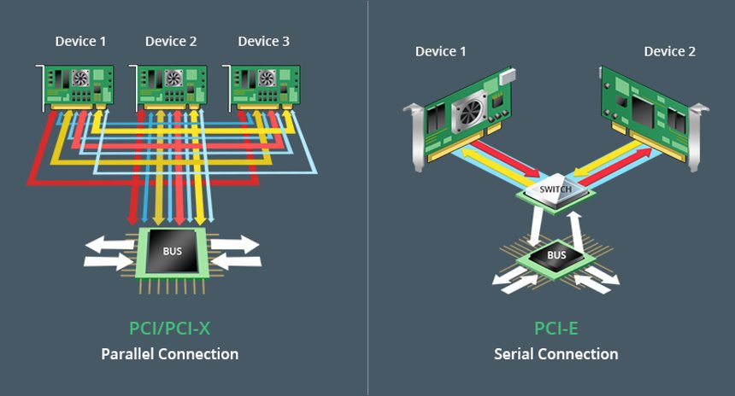

Slide 7
About PCIe
PCIe is the point to point serial transfer protocol with master - slave configuration.
The data is transferred in the form of packets.
PCI Express devices communicate with each other through a logical connection called as interconnect or link.
This link is the point-to-point communication channel between two PCI Express ports allowing both of them to send and receive ordinary PCI requests and interrupts.
Next comes Lane, Lane is composed of two differential pairs. One pair is for transmitting and other pair for receiving the data.

Slide 8
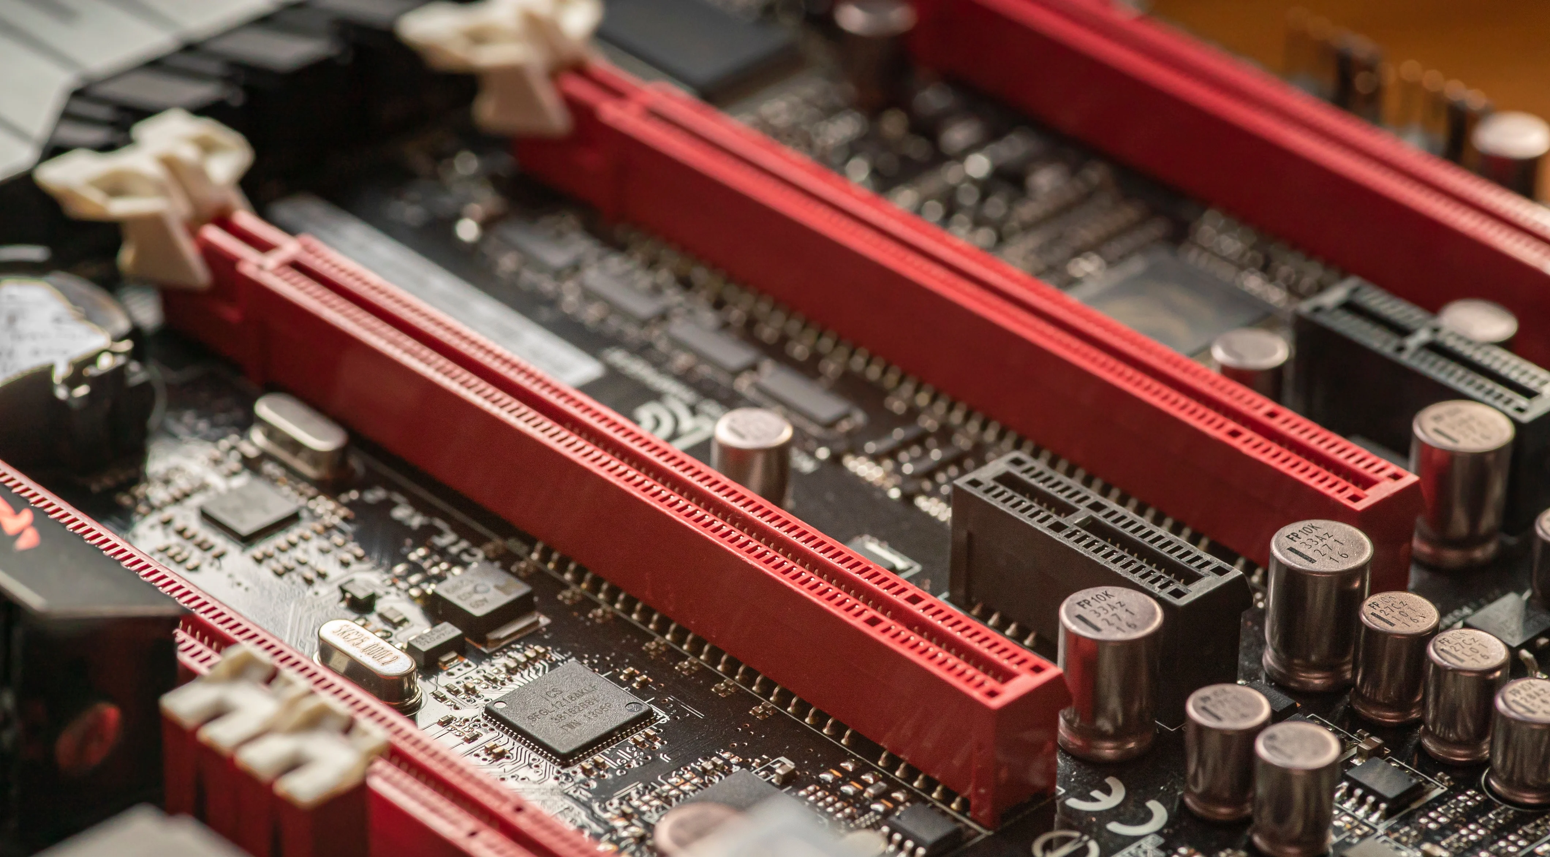
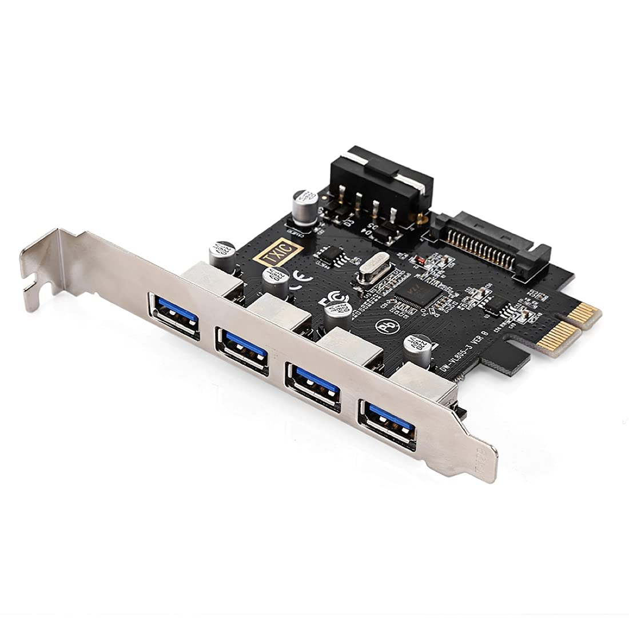
On every mother board there are slots for either PCI or PCIe.
Peripheral components such as Graphics card or sound cards can be connected to this.
To connect the USB ports or HDMI ports to our PC, we use PCIe card. This PCIe card is inserted into the slots available for PCIe on the mother board. And the external peripheral components are connected to this.

Slide 9
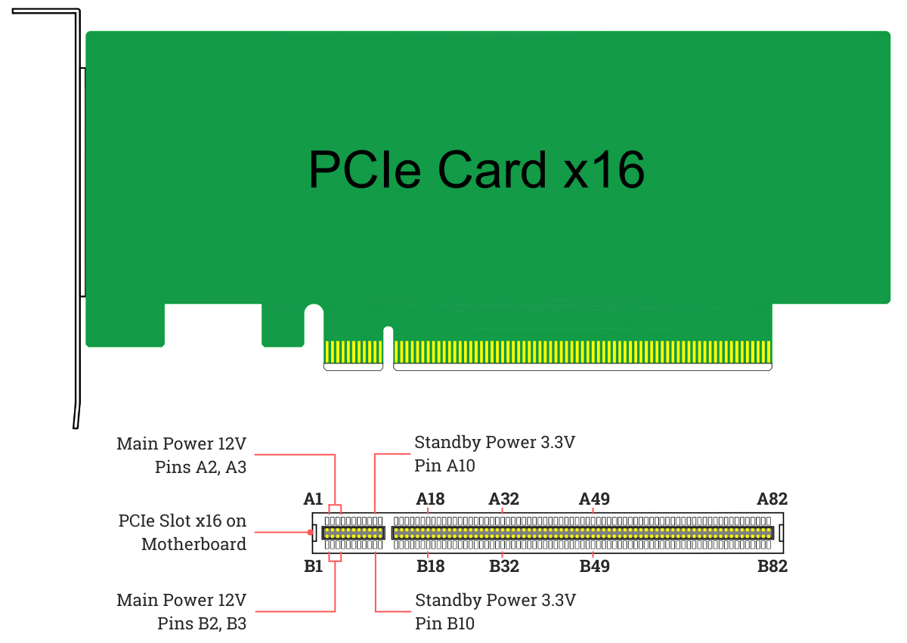
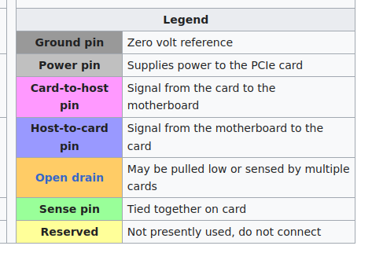
Now these PCIe slots and PCIe card have some pin configuration.

Slide 10
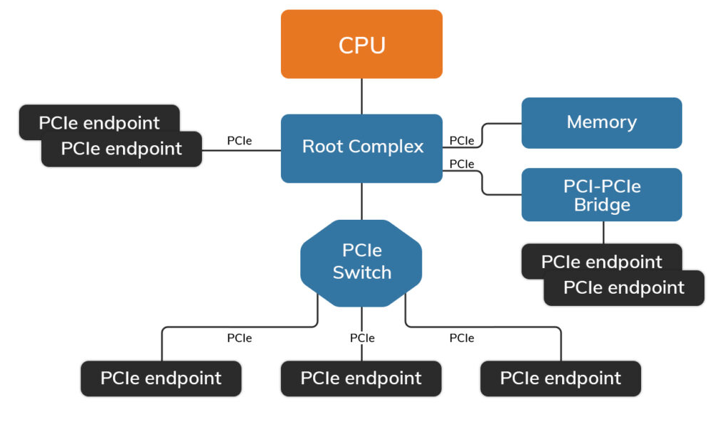
Topology of PCIe
It acts on behalf of CPU to communicate with the rest of the devices. It connects CPU to PCIe topology.
Switch manages multiple incoming PCI-Express streams.
They are adapters that allow PCI devices to connect to PCIe slots in systems by doing protocol conversions
End point is nothing but the point where we can connect external peripheral components.

Slide 11
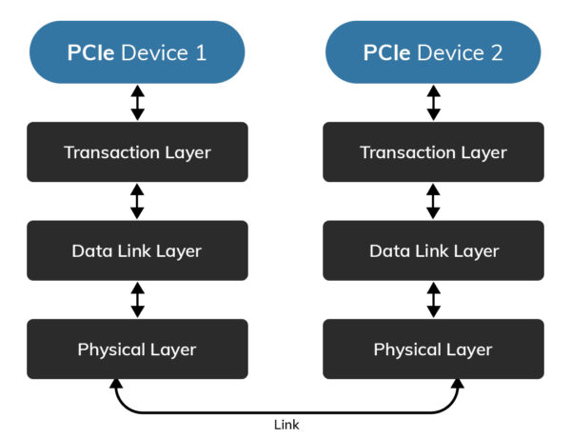
Flow of PCIe protocol communication
PCI-Express works based on three layers. Those layers are nothing but transaction layer, Physical layer and Data-link layer.
PHYSICAL LAYER:
A PCIe physical layer specification is divided into two sub-layers, corresponding to logical and electrical specifications.
This physical layer is used to connect two PCIe devices through a link.

Slide 12
DATA LINK LAYER:
The data link layer performs three vital services for the PCIe link:
Sequence the transaction layer packets (TLPs) that are generated by the transaction layer.
Ensure reliable delivery of TLPs between two endpoints via an acknowledgement protocol (ACK and NAK signaling) that explicitly requires replay of unacknowledged/bad TLPs.
Initialize and manage flow control credits.
TRANSCATION LAYER:
Transaction layer consists of TLP’s nothing but Transaction layer packets. Here the information is sent in the form of packets.
This TLP’s consists of Headers and Payload fields.
Header Data (Payload)
( 3 – 4 DW) ( 0 – 1023 DW)

Slide 13
Applications of PCIe
PCI Express operates in consumer, server, and industrial applications.
It is used as a motherboard-level interconnect (to link motherboard-mounted peripherals)
It is used as a passive backplane interconnect.
And also used as an expansion card interface for add-in boards.

Slide 14
References
https://en.wikipedia.org/wiki/PCI_Express
https://prodigytechno.com/pci-express-pcie-or-pci-e/
https://computer.howstuffworks.com/pci-express.htm
https://community.fs.com/blog/pci-vs-pci-x-vs-pci-e-why-choose-pci-e-card.html
https://programmathically.com/how-pci-express-and-pci-work-an-introduction/

Slide 15
Thank You

